Slide 1




Lesson 4a: Configuring Security Policies
MOAC 70-410: Installing and Configuring Windows Server 2012

Slide 2

Overview
Exam Objective 6.2: Configure Security Policies
Configuring Security Policies Using Group Policy
Configuring Local Users and Groups
Configuring User Account Control

Slide 3


Configuring Security Policies Using Group Policy
Lesson 17: Configuring Security Policies

Slide 4


Configuring Security Policies Using Group Policy
One of the primary aims of Group Policy is to provide centralized management of security settings for users and computers.
Most of the settings that pertain to security are found in the Windows Settings folder within the Computer Configuration node of a Group Policy object (GPO).
You can use security settings to govern how users are authenticated to the network, the resources they are permitted to use, group membership policies, and events related to user and group actions recorded in the event logs.

Slide 5

Defining Local Policies
Local Policies enable administrators to set user privileges on the local computer to govern what users can do on the computer and determine if the system should track them in an event log.
Auditing is tracking events that take place on the local computer.
The Local Policies node of a GPO has three subordinate nodes: User Rights Assignment, Security Options, and Audit Policy.

Slide 6


Planning and Configuring an Audit Policy
The Audit Policy section of a GPO enables administrators to log successful and failed security events, such as logon events, account access, and object access.
You can use auditing to track both user activities and system activities.
Planning to audit requires that you determine the computers to be audited and the types of events you wish to track.

Slide 7


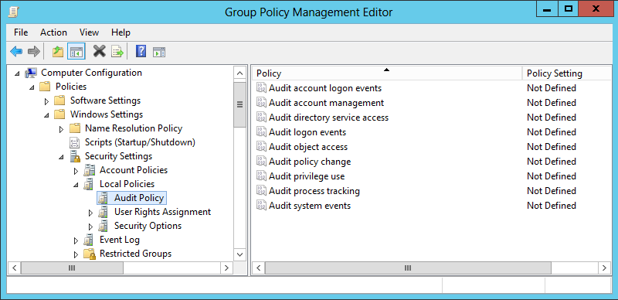
Planning and Configuring an Audit Policy
Audit Policies in the Default Domain Policy

Slide 8
Planning and Configuring an Audit Policy
The following guidelines can help you to plan your audit policy:
Audit only pertinent items.
Archive security logs to provide a documented history.
Configure the size of your security logs carefully.

Slide 9

Event Categories
System events
Policy change events
Account management events
Logon events
Account logon events

Slide 10

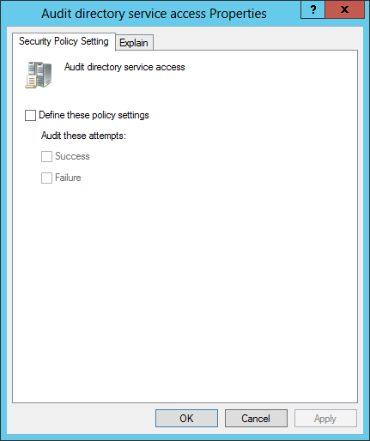
Configure an Audit Policy
The Properties sheet for a policy setting

Slide 11


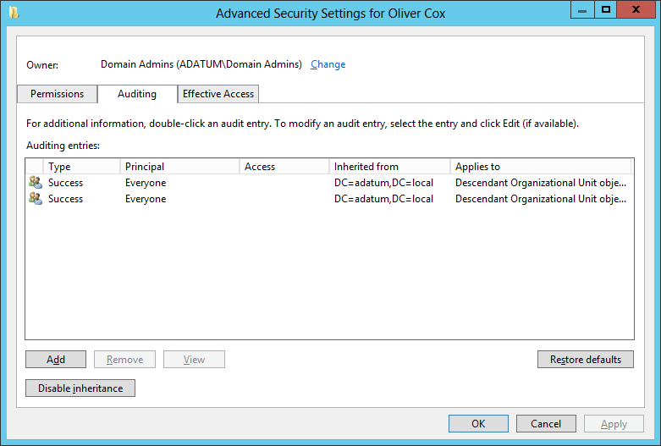
Configure an Active Directory Object for Auditing
The Auditing tab of an object’s Advanced Security Settings dialog box

Slide 12
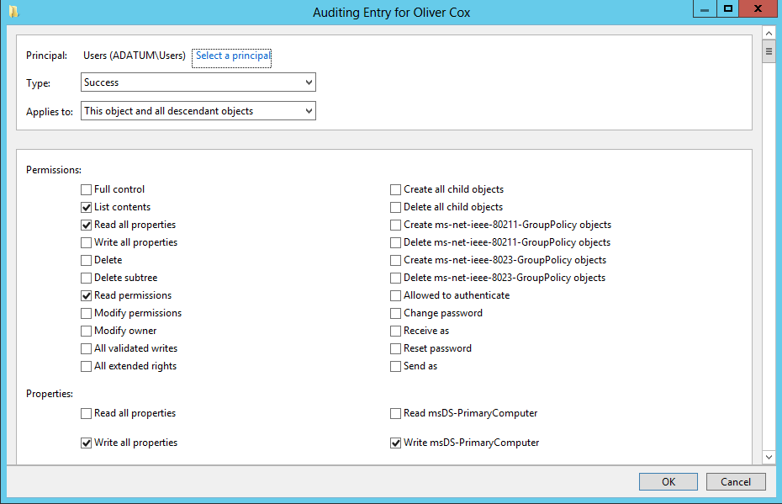
Configure an Active Directory Object for Auditing
The Auditing Entry dialog box for an object

Slide 13
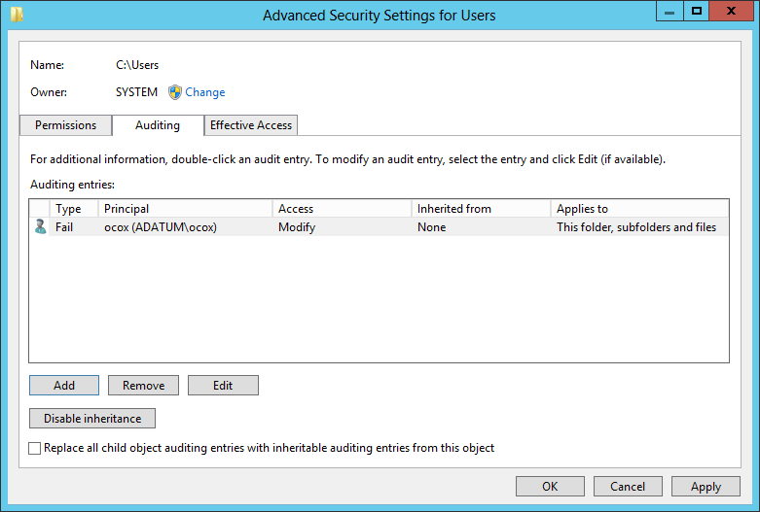
Configure an Active Directory Object for Auditing
A new auditing entry in the Advanced Security Settings dialog box

Slide 14

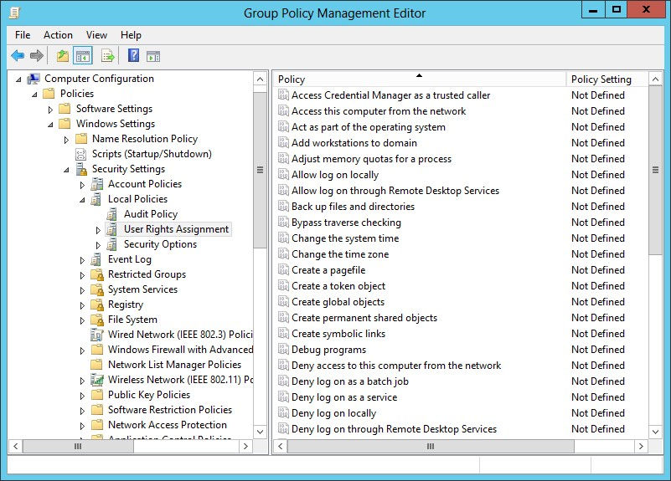
Assigning User Rights
User rights assignment settings in a Group Policy object

Slide 15

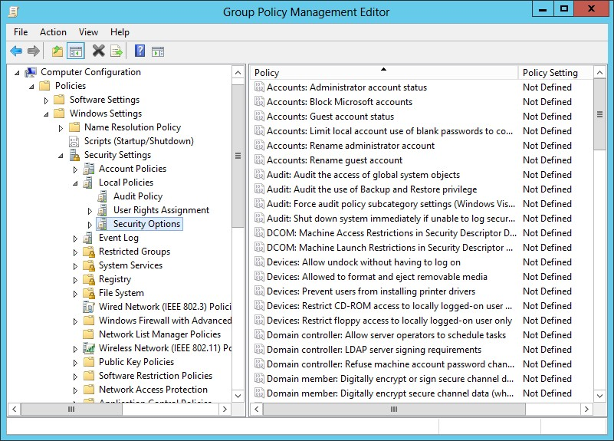
Configuring Security Options
The Security Options node in a GPO

Slide 16
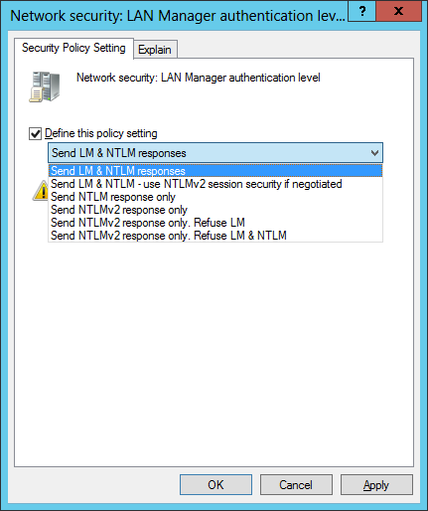
Configuring Security Options
The Network security: LAN Manager authentication level security option

Slide 17

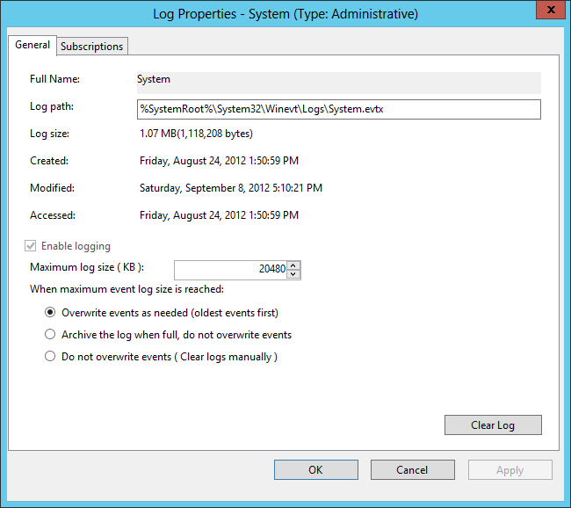
Customizing Event Log Policies
The Properties sheet for an event log in the Event Viewer console

Slide 18
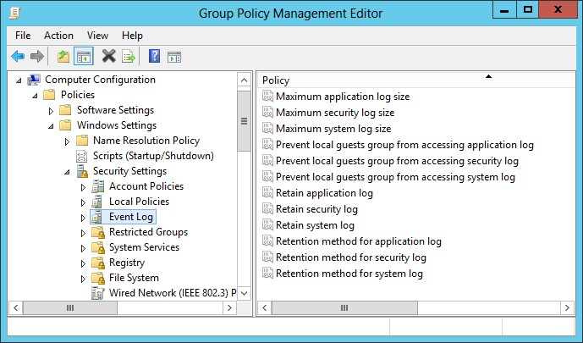
Customizing Event Log Policies
Policies in the Event Log node of a GPO

Slide 19

Restricted Groups
The Restricted Groups policy setting enables an administrator to specify group membership lists.
You can control membership in important groups, such as the local Administrators and Backup Operators groups.
Only those users who are part of the Restricted Group membership list within the policy setting will be added to the group.

Slide 20

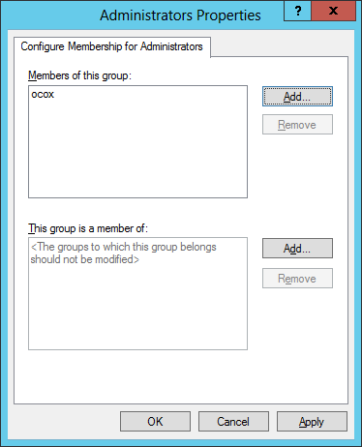
Restricted Groups
Group membership in the Restricted Groups policy

Slide 21

Security Templates
A security template is a collection of configuration settings stored as a text file with an .inf extension.
Can contain many of the same security parameters as group policy objects.
Parameters are presented in a unified interface, enabling you to save your configurations as files and simplify the process of deploying them.

Slide 22
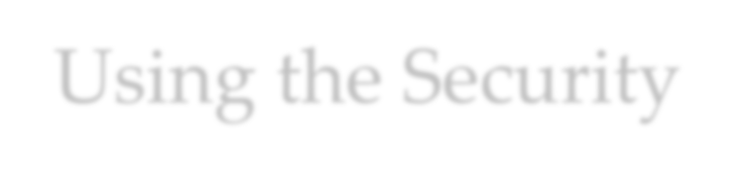
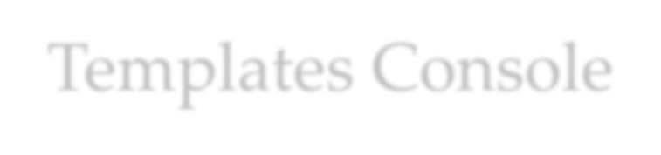
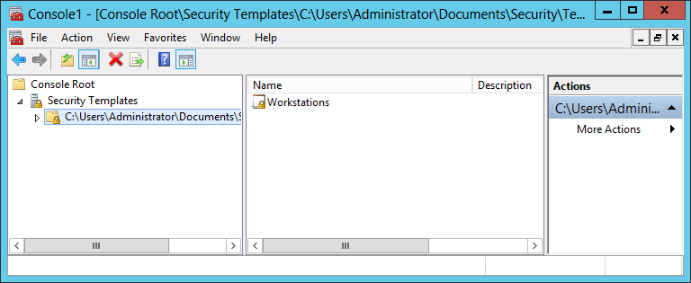
Using the Security Templates Console
The Security Templates snap-in

Slide 23


Security Template Planning
By creating templates for specific roles, administrators can apply them to multiple computers, using combinations in cases where computers perform multiple roles.

Slide 24


Working with Security Template Settings
Security templates have more settings than Local Computer Policy, because a template includes options for both standalone computers and computers that are participating in a domain.
Security templates also provide a means for configuring the permissions associated with files, folders, registry entries, and services.

Slide 25


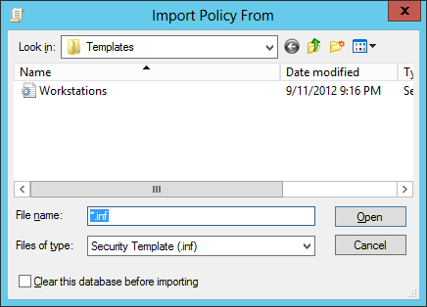
Importing Security Templates into GPOs
The Import Policy From dialog box

Slide 26


Maintaining and Optimizing Group Policy
These are the default refresh periods for the various types of Group Policy settings:
Set Group Policy Refresh Interval for Computers
Set Group Policy Refresh Interval for Domain Controllers
Set Group Policy Refresh Interval for Users

Slide 27


Manually Refreshing Group Policy
When you modify Group Policy settings that you wish to be immediately invoked without requiring a restart, a new logon session, or waiting for the next refresh period, you can force a manual refresh by using the Gpupdate.exe tool:
Gpupdate/target:user
Gpupdate/target:computer

Slide 28


Optimizing Group Policy Processing
When you create a GPO that contains computer or user settings, but not both, you can disable the setting area that is not configured for faster processing.

Slide 29


Configuring Local Users and Groups
Lesson 17: Configuring Security Policies

Slide 30


Configuring Local Users and Groups
Windows Server 2012 provides two separate interfaces for creating and managing local user accounts:
User Accounts control panel
Local Users and Groups snap-in for MMC Both interfaces provide access to the same
Security Account Manager (SAM) where the user and group information is stored, so any changes you make using one interface will appear in the other.

Slide 31


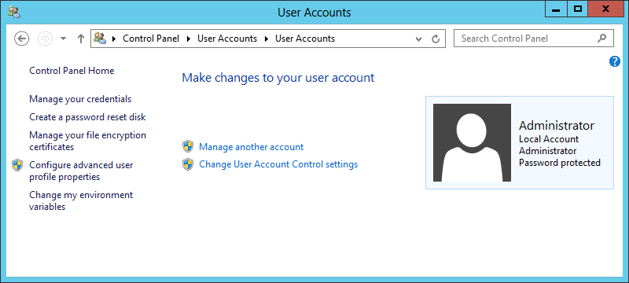
Create a New Local User Account with the Control Panel
The Make changes to your user account window

Slide 32
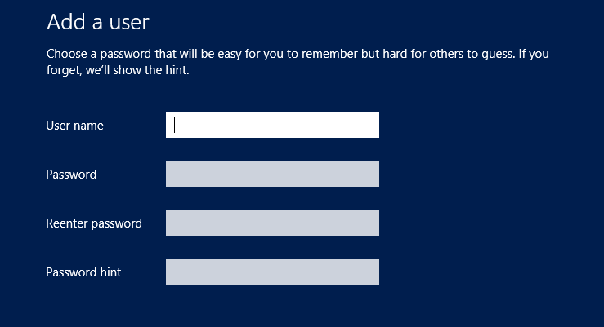
Create a New Local User Account with the Control Panel
The Add a user page

Slide 33
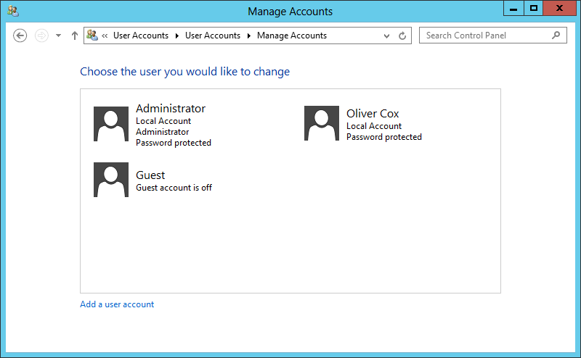
Create a New Local User Account with the Control Panel
The Manage Accounts window

Slide 34
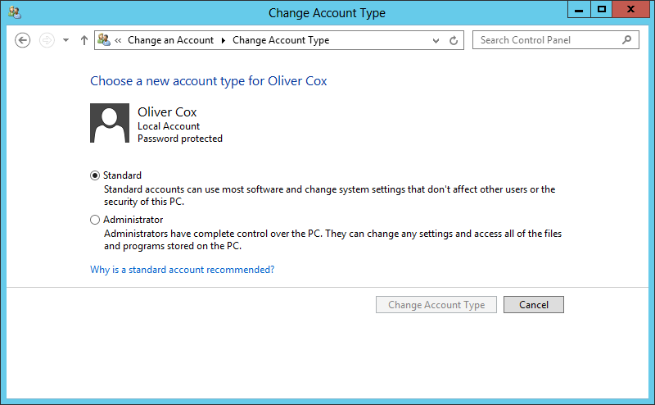
Create a New Local User Account with the Control Panel
The Change Account Type window

Slide 35

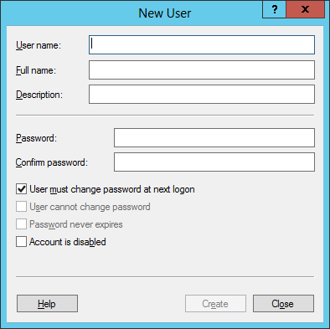
Create a New Local User Account with Local Users and Groups
The New User dialog box

Slide 36

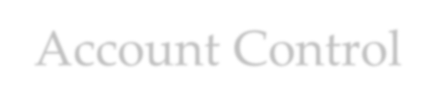
Configuring User Account Control
Lesson 17: Configuring Security Policies

Slide 37

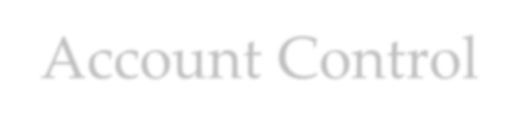
Configuring User Account Control
User Account Control (UAC) is the mechanism that prevents users from accessing the system using administrative privileges unless those privileges are required to perform the task at hand.
Administrators should only log on to a server using an account with administrative access when performing administrative tasks; however, it is often inconvenient to switch back and forth between an administrative account and standard user account.

Slide 38

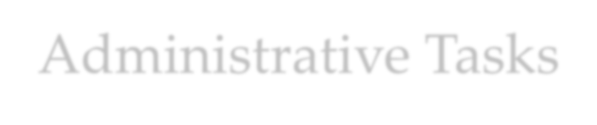
Performing Administrative Tasks
When a user logs on to Windows Server 2012, the system issues a token, which indicates the user’s access level.
Whenever the system authorizes the user to perform a particular activity, it consults the token to see if the user has the required privileges.
On a computer running Windows Server 2012 with User Account Control, a standard user still receives a standard user token, but an administrative user receives two tokens: one for standard user access and one for administrative user access.
By default, the standard and administrative users both run using the standard user token most of the time.

Slide 39

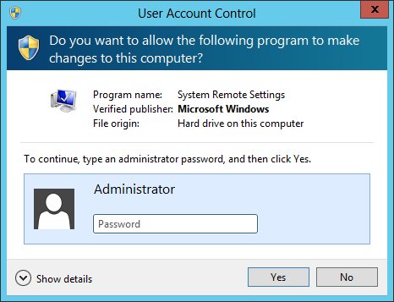
Performing Administrative Tasks
A UAC credential prompt

Slide 40
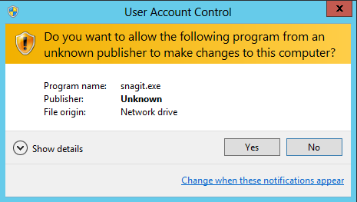
Performing Administrative Tasks
A UAC elevation prompt

Slide 41

Secure Desktop
The secure desktop is an alternative to the interactive user desktop that Windows normally displays.
When an elevation or credential prompt is generated, the system switches to the secure desktop, suppressing the operation of all other desktop controls and permitting only Windows processes to interact with the prompt.
The object of this is to prevent malware from automating a response to the elevation or credential prompt and bypassing the human reply.

Slide 42

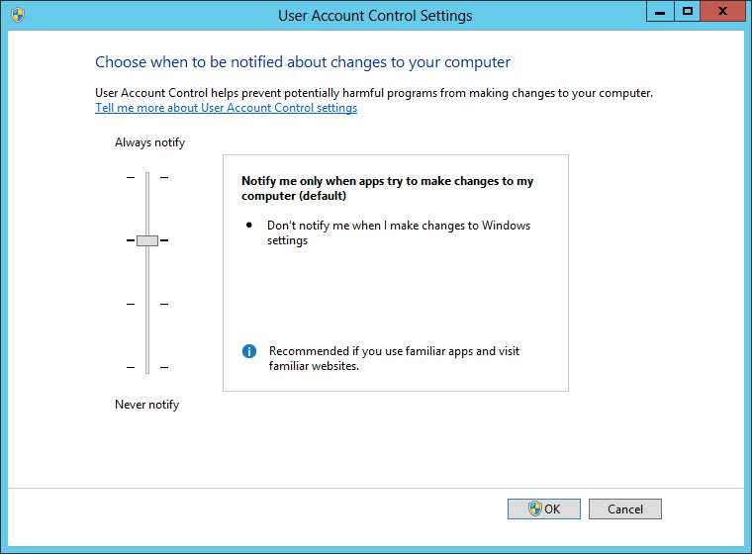
Configure UAC Settings
The User Account Control Settings dialog box

Slide 43
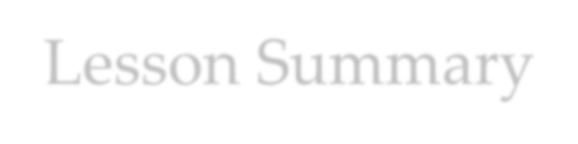
Lesson Summary
Most security-related settings are found within the Windows
Settings node of the Computer Configuration node of a GPO.
Local policy settings govern the actions users can perform on a specific computer and determine if the actions are recorded in an event log.
Auditing can be configured to audit successes, failures, or
both.
Because audited events are recorded in the appropriate event log, it is necessary to understand the Event Log Policy setting area. This area allows control over maximum log sizes, log retention, and access rights to each log.
Restrictions on group memberships can be accomplished using the Group Restriction Policy setting. Implementing this policy removes group members who are not part of the configured group membership list or adds group members according to a preconfigured list.

Slide 44
Lesson Summary
Administrators can use security templates to configure local policies, group memberships, event log settings, and other policies.
Computer configuration group policies are refreshed every 90 minutes by default. Domain controller group policies are refreshed every 2 minutes. These settings can be altered based on the frequency in which policy changes occur.
When a standard user attempts to perform a task that requires administrative privileges, the system displays a credential prompt, requesting that the user supply the name and password for an account with administrative privileges.
User Account Control is enabled by default in all Windows Server 2012 installations, but it is possible to configure its properties, or even disable it completely, using Group Policy.

Slide 45
Copyright 2013 John Wiley & Sons, Inc.
All rights reserved. Reproduction or translation of this work beyond that named in Section 117 of the 1976 United States Copyright Act without the express written consent of the copyright owner is unlawful. Requests for further information should be addressed to the Permissions Department, John Wiley & Sons, Inc. The purchaser may make back-up copies for his/her own use only and not for distribution or resale. The Publisher assumes no responsibility for errors, omissions, or damages, caused by the use of these programs or from the use of the information contained herein.

